Slide 1
AGILE METHODOLOGIES
Team members-
Rochita Bagchi
Haya Fatima
Sandeep Chand Ranjan
Satish

Slide 2
AGILE methodology is a practice that promotes continuous iteration of development and testing throughout the software development lifecycle of the project.
The agile software development emphasizes on four core values.
1) Individual and team interactions over processes and tools
2) Working software over comprehensive documentation
3) Customer collaboration over contract negotiation
4) Responding to change over following a plan

Slide 3
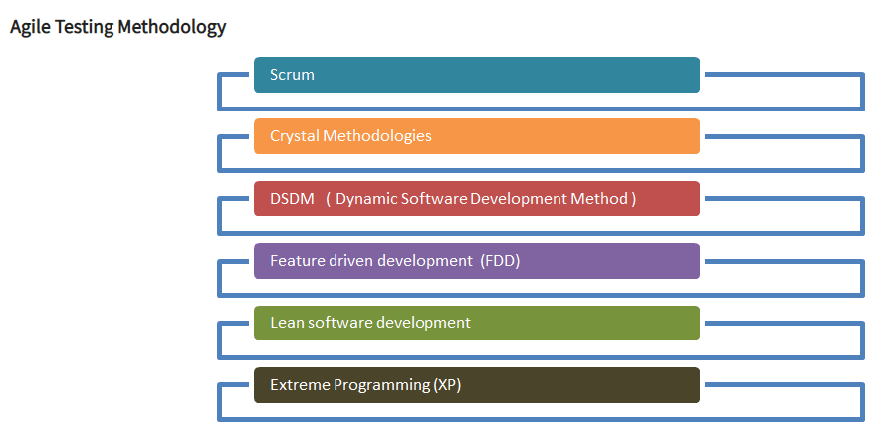
Agile Testing Methodology

Slide 4
SCRUM
SCRUM is an agile development method which concentrates specifically on how to manage tasks within a team-based development environment.
Basically, Scrum is derived from activity that occurs during a rugby match. Scrum believes in empowering the development team and advocates working in small teams (say- 7 to 9 members).
It consists of three roles, and their responsibilities are explained as follows:
Scrum Master
Master is responsible for setting up the team, sprint meeting and removes obstacles to progress
Product owner
The Product Owner creates product backlog, prioritizes the backlog and is responsible for the delivery of the functionality at each iteration
Scrum Team
Team manages its own work and organizes the work to complete the sprint or cycle

Slide 5
Extreme Programming
Extreme Programming technique is very helpful when there is constantly changing demands or requirements from the customers or when they are not sure about the functionality of the system. It advocates frequent "releases" of the product in short development cycles, which inherently improves the productivity of the system and also introduces a checkpoint where any customer requirements can be easily implemented. The XP develops software keeping customer in the target.

Slide 6
Role of Scrub Master in Agile model
Facilitate his team for better creativity and tries to improve the efficiency of the development team.
Responsible for managing the scrum process with the coordination of scrum team in Agile methodology.
Responsible to remove the impediments for the scrum team.
Helps product owner to make the product backlogs in good shape and make them ready for the next sprint.
Acts as safeguard for his team.

Slide 7
Lean Software Development
Lean software development method is based on the principle "Just in time production". It aims at increasing speed of software development and decreasing cost. Lean development can be summarized in seven steps.
Eliminating Waste
Amplifying learning
Defer commitment (deciding as late as possible)
Early delivery
Empowering the team
Building Integrity
Optimize the whole

Slide 8
User Stories
A user story is a tool used in Agile software development to capture a description of a software feature from an end-user perspective. The user story describes the type of user, what they want and why. A user story helps to create a simplified description of a requirement.
A user story template often uses the following type of format:
As a <role>, I want <feature> so that <reason>.
Examples of user stories are:
As a user, I want to upload photos so that I can share photos with others.
As an administrator, I want to approve photos before they are posted so that I can make sure they are appropriate.

Slide 9
Sprint Planning
In product development, a sprint is a set period of time during which specific work has to be completed and made ready for review.
Each sprint begins with a planning meeting. During the meeting, the product owner (the person requesting the work) and the development team agree upon exactly what work will be accomplished during the sprint. The development team has the final say when it comes to determining how much work can realistically be accomplished during the sprint, and the product owner has the final say on what criteria need to be met for the work to be approved and accepted.

Slide 10
Retrospection
An Agile retrospective is a meeting that's held at the end of an iteration in Agile software development (ASD). During the retrospective, the team reflects on what happened in the iteration and identifies actions for improvement going forward.
Each member of the team members answers the following questions:
What worked well for us?
What did not work well for us?
What actions can we take to improve our process going forward?
The Agile retrospective can be thought of as a "lessons learned" meeting.

Slide 11
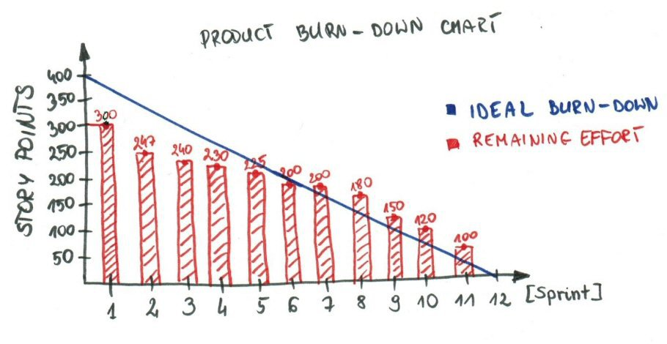
Burn down Chart
The burn down is a chart that shows how quickly you and your team are burning through your customer's user stories. It shows the total effort against the amount of work we deliver each iteration.

Slide 12
Poker planning
Planning poker, also called Scrum poker, is a consensus-based, gamification technique for estimating, mostly used to estimate effort or relative size of development goals in software development. In planning poker, members of the group make estimates by playing numbered cards face-down to the table, instead of speaking them aloud. The cards are revealed, and the estimates are then discussed. By hiding the figures in this way, the group can avoid the cognitive bias of anchoring, where the first number spoken aloud sets a precedent for subsequent estimates.

Slide 13

Daily Standup
In Daily Standup, the team holds a daily scrum meeting called the “daily scrum.” Meetings are typically held in the same location and at the same time each day. Ideally, a daily scrum meeting is held in the morning, as it helps set the context for the coming day's work. These scrum meetings are strictly time-boxed to 15 minutes. This keeps the discussion brisk but relevant.

Slide 14
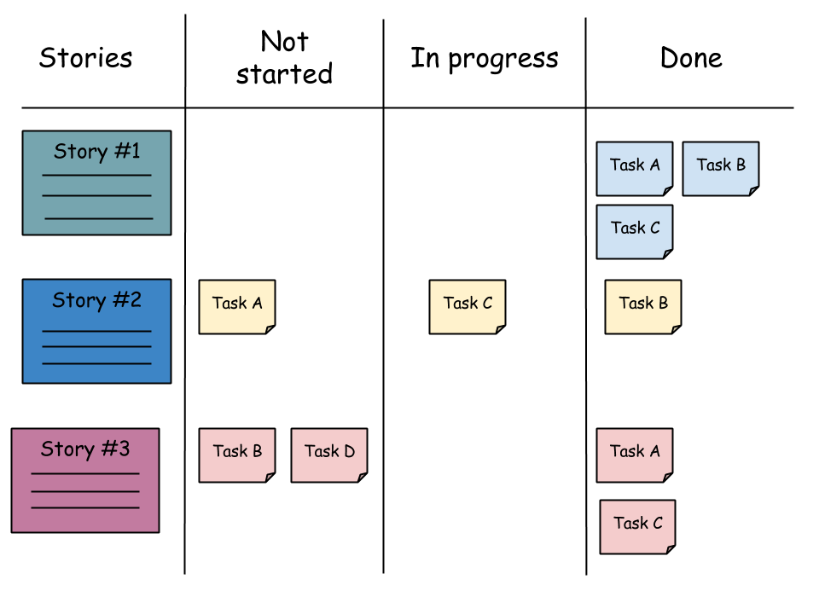
Scrum Board
Simply put, the Scrum board is a physical board on which the user stories which make up the current sprint backlog, along with their constituent tasks, are displayed. Usually this is done with index cards or post-it notes.
The task board is a visual display of the progress of the Scrum team during a sprint. It presents a snapshot of the current sprint backlog allowing everyone to see which tasks remain to be started, which are in progress and which are done.

Slide 15
Kanban
Kanban is a method for managing the creation of products with an emphasis on continual delivery while not overburdening the development team. Like Scrum, Kanban is a process designed to help teams work together more effectively.
Kanban promotes continuous collaboration and encourages active, ongoing learning and improving by defining the best possible team workflow.
Both Kanban and Scrum focus on releasing software early and often. Both require highly-collaborative and self-managed teams

Slide 16
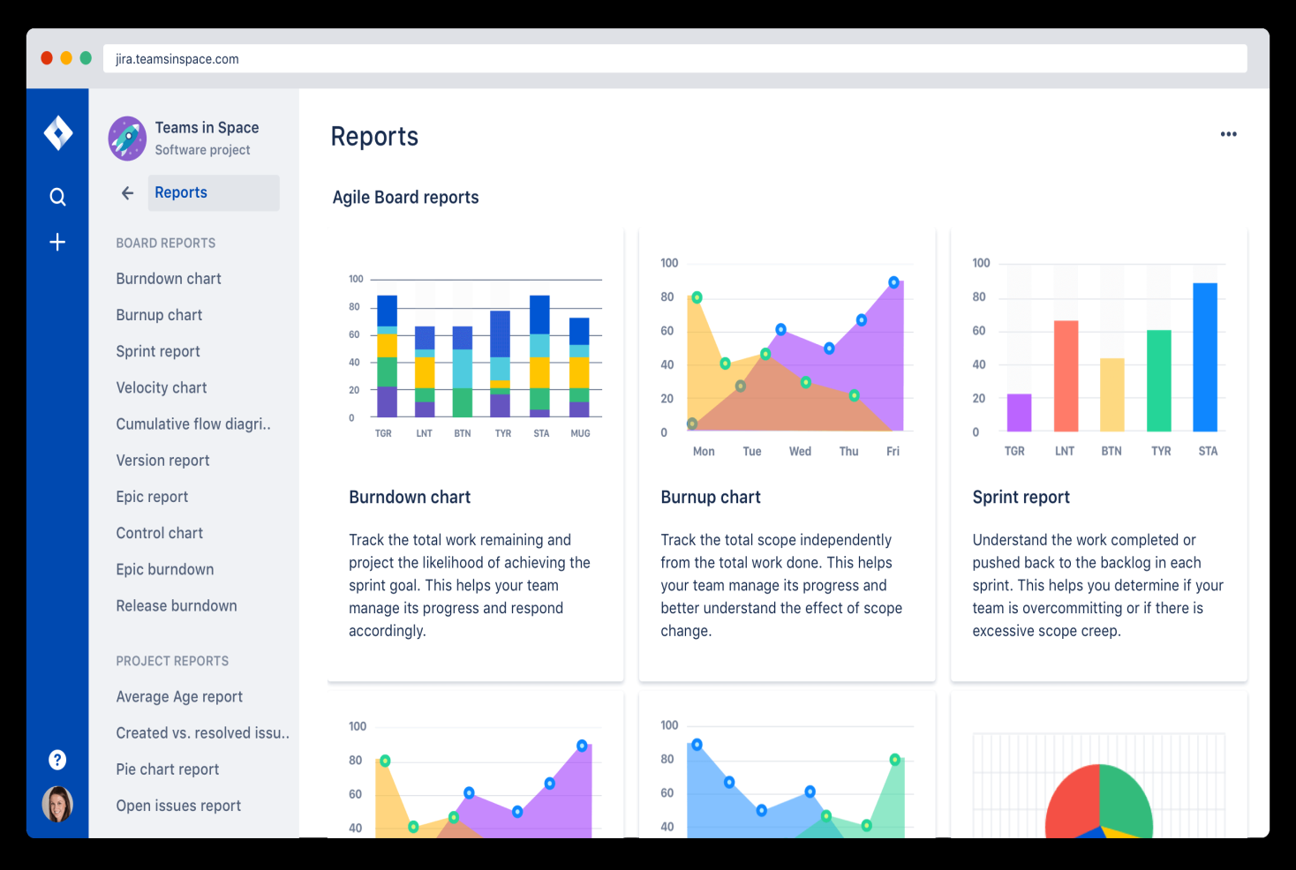
Jira
Jira Software is an agile project management tool that supports any agile methodology, be it scrum, kanban, or your own unique flavor. From agile boards to reports, you can plan, track, and manage all your agile software development projects from a single tool.

Slide 17
Role of Product Owner
The Product owner is typically a project's key stakeholder. Part of the product owner responsibilities is to have a vision of what he or she wishes to build, and convey that vision to the scrum team. This is key to successfully starting any agile software development project. The agile product owner does this in part through the product backlog, which is a prioritized features list for the product.

Slide 18
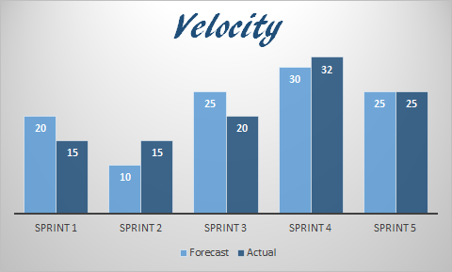
Velocity
At the end of each iteration, the team adds up effort estimates associated with user stories that were completed during that Iteration. This total is called velocity.
Knowing velocity, the team can compute (or revise) an estimate of how long the project will take to complete, based on the estimates associated with remaining user stories and assuming that velocity over the remaining iterations will remain approximately the same. This is generally an accurate prediction, even though rarely a precise one.

Slide 19
Sprint Backlog
The Sprint Backlog is an ordered list of Product Backlog Items, preferably User Stories, that the Team believes it can complete during the coming Sprint. These items are pulled from the top of the Product Backlog during the Sprint Planning Meeting.
The Sprint Backlog is an ordered list of Product Backlog Items, preferably User Stories, that the Team believes it can complete during the coming Sprint. These items are pulled from the top of the Product Backlog during the Sprint Planning Meeting.

Slide 20
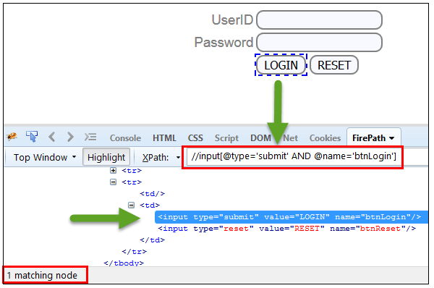
XPath
XPath is defined as XML path. It is a syntax or language for finding any element on the web page using XML path expression.
In Selenium automation, if the elements are not found by the general locators like id, class, name, etc. then XPath is used to find an element on the web page .

Slide 21
Thank You

Slide 22
Feature Driven Development

